Slide 1



Department of Electronics and Communication Engineering
Team Vibhav
Automated Covid Gateway
Total Cost of the Project: 4600 Rs

Slide 2

Overview
About the project
Problem the project solves
Solution to the problem
Techstack
Novelty of the solution
Social Applications
How does the project works
Business Aspects
Cost Analysis

Slide 3

About the project
This project has been made with the aim to improve present pandemic conditions.
It is an automatic device that will be used to detect mask and measure human body temperature and sanitize hands.
This project will reduce the contact and will even reduce the extra labour needed for the whole process.
The device works automatically with the use of sensors and needs no button to operate ,which makes it contactless and suitable for present circumstances.

Slide 4
Problems the project solves
The smooth and contactless functioning in this pandemic.
Spread Awareness about Covid-19 precautions.
Contact between people during the temperature detection .
A cost efficient device to perform multiple operations.

Slide 5
Solution to the problems
Our Project is made to prevent the spread of Covid-19.
A multipurpose device for temperature measurement and mask detection will be designed.
A sanitizing device and automatic door opening technology will also be used.
It is a contactless device so it will be more effective in the present pandemic situation.
It also reduces the extra labour needed for this process.

Slide 6

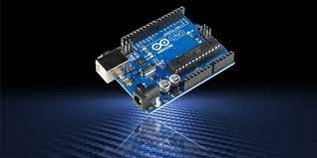

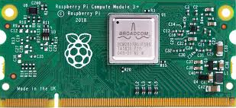
Techstack
OpenCV
Machine learning
IoT
Passive Infrared Sensor
Arduino Uno
Raspberry Pi 3 Model B
Raspberry Pi camera module V2
Temperature Sensor MLX90614
Visual Studio Code
Servo Motor

Slide 7

How does the project works ?
When any person puts his/her hand in front of the device ,then it checks the body temperature using the temperature sensor MLX90614 .
Simultaneously it checks whether the person is wearing mask or not using Machine learning.
If required conditions are satisfied then only the door will automatically open.
If required conditions are not satisfied then the device glows a red LED and alerts everyone using buzzer.

Slide 8
Novelty of the solution
This project is very suitable for the present situation of Covid-19 . It reduces the contact that will control the spread of the virus and will help a lot according to the current scenario.
Our project is available at an affordable cost of Rs.4600 that will be beneficial for the users .

Slide 9
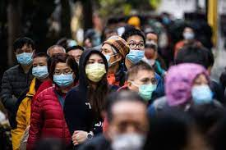
Social Applications
This device can be used outside hospitals, malls and schools etc.
This will help us to reduce the outspread of COVID-19.
It reduces the man power as the device operates automatically.
It is a contactless device so its more useful in present pandemic situation.
The device can perform multiple operations/functions.
It makes the process of mask detection and temperature detection more easy.

Slide 10
Business Aspects
It will reduce the contact and will help in reducing the outspread of Covid-19.So, it will be a beneficial device in this pandemic time ,that reduces the labour needed to detect temperature and sanitize hands.
This product will make the whole process easy and quick .
The product will replace the manpower needed that will be profitable for the users.

Slide 11
Cost Analysis
S.no. | Item | Specification | Quantity | Cost
1. | Raspberry Pi 3 | - | 1 | 2600
2. | Raspberry Pi camera Module V2 | - | 1 | 300
3. | Arduino UNO | - | 1 | 350
4. | PIR (passive infrared) sensor | - | 1 | 100
5. | Servo Motor | - | 1 | 250
6. | Temperature sensor (MLX90614) | - | 1 | 1000
 |  |  | Total Cost | 4600

Slide 12
We are here to solve all your doubts regarding the project……..
Thank you...
Stay tuned with our social media handles..

